Slide 1
Pointers in C

Slide 2
Pointers in C
The pointer in C language is a variable which stores the address of another variable. This variable can be of type int, char, array, function, or any other pointer. The size of the pointer depends on the architecture. However, in 32-bit architecture the size of a pointer is 2 byte.

Slide 3
Address of Operator
& is known as address of operator.
It is an unary operator.
Operand must be the name of variable
& operator gives address number of variable.
& is also known as referencing operator

Slide 4
Indirection operator
*
It is also known as deferenencing operator .
It is an unary operator.
It takes address as an argument

Slide 5
%d => -32768 to 32767
%u => 0 to 65535

Slide 6
#include<stdio.h>
main(){
int x = 5;
printf("%d\n",x);
printf("%u",&x);
}
p1.c
pointer2.c

Slide 7
Question
int x = 5;
&x=7;

Slide 8
Question
int x = 5;
&x=7;
We cannot store anything in &x because &x is not a variable . It is the way to represent address of block x.

Slide 9
But
We can store address in another variable , but j has to be declared before use.
int x = 5;
int *j;
j =&x;

Slide 10
Pointer variable
Ex → *p
Pointer is a variable that contains address of another variable.
Pointer always consumes 2 bytes in memory.

Slide 11
Consider the following example to define a pointer which stores the address of an integer.
int n = 10;
int* p = &n; // Variable p of type pointer is pointing to the address of the variable n of type integer.
The pointer in c language can be declared using * (asterisk symbol). It is also known as indirection pointer used to dereference a pointer.
int *a;//pointer to int
char *c;//pointer to char
pointer1.c

Slide 12
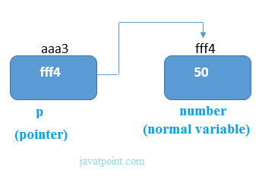

Slide 13
Question
main(){
int x =5, *j;
j=&x;
printf(“%d %u \n”,x,j);
printf(“%d %u \n”,*j,&x);
printf(“%u”,*&j);
}
p2.c

Slide 14
Advantages
1) Pointer reduces the code and improves the performance, it is used to retrieving strings, trees, etc. and used with arrays, structures, and functions.
2) We can return multiple values from a function using the pointer.
3) It makes you able to access any memory location in the computer's memory.

Slide 15
Usage of pointer
There are many applications of pointers in c language.
1) Dynamic memory allocation
In c language, we can dynamically allocate memory using malloc() and calloc() functions where the pointer is used.
2) Arrays, Functions, and Structures
Pointers in c language are widely used in arrays, functions, and structures. It reduces the code and improves the performance

